Slide 1
Chapter 3 Objectives
The CCNA Topics Covered in this chapter include:
  What is CDP?
  CDP configuration
  How to verify CDP?

Slide 2
Cisco Discovery Protocol (CDP)
A Cisco proprietary protocol
  - Designed to collect information about directly attached & remote devices
    Hardware information
    Protocol information
  - Useful in troubleshooting & documenting the network

Slide 3
Getting CDP Timers & Holdtime Information
Configuration
  CDP Timer: How often CDP packets are transmitted to all active interfaces
  CDP Holdtime: The amount of time that the device will hold packets received from neighbor devices
      Router#sh cdp
      Global CDP information
      Sending CDP packets every 60 seconds
      Sending a holdtime value of 180 seconds
      Router#config t
      Router(config)#cdp timer 90
      Router(config)#cdp holdtime 240

Slide 4
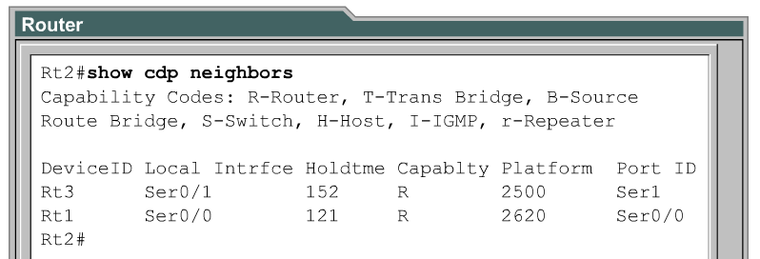
Implementation, monitoring, and maintenance of CDP
This router’s interface
Remote router’s interface
The cdp run command is used to enable CDP globally on the router.
By default, CDP is globally enabled.
The cdp enable command is used to enable CDP on a particular interface.
On Cisco IOS Release 10.3 or higher, CDP is enabled by default on all supported interfaces to send and receive CDP information.
CDP could be enabled on each of the devices interfaces by using the cdp enable command.

Slide 5
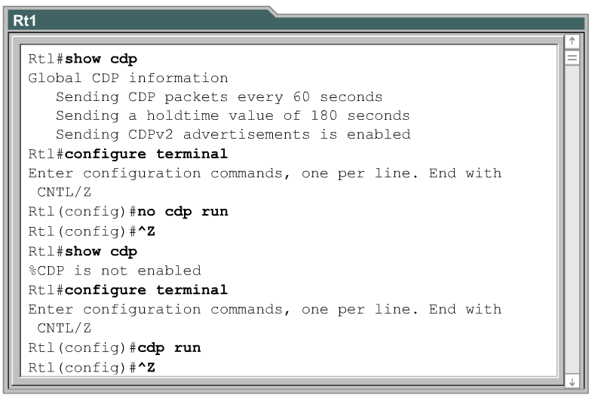
Disabling CDP
To disable CDP on a specific interface after it has been enabled, use the no CDP enable command in interface configuration mode.

Slide 6
Router# show cdp neighbor detail
-------------------------
Device ID: RouterA
Entry address(es):
IP address: 172.16.1.1
Platform: cisco 4500, Capabilities: Router
Interface: Ethernet0/0, Port ID (outgoing port): Ethernet0/1
Holdtime : 137 sec
Version :
Cisco Internetwork Operating System Software
IOS (tm) 4500 Software (C4500-J-M), Version 11.1.10,
MAINTENANCE INTERIM SOFTWARE
Copyright (c) 1986-1997 by cisco Systems, Inc.
Compiled Mon 07-Apr-97 19:51 by dtsa

Slide 7
CDP is enabled, by default, on all Cisco devices.
CDP updates are generated as multicasts every 60 seconds
with a hold-down period of 180 seconds for a missing neighbor.
The no cdp run command globally disables CDP, while the no cdp enable command disables CDP on an interface.
Use show cdp neighbors to list out your directly connected Cisco
neighboring devices.
Adding the detail parameter will display the layer-3 addressing configured on the neighbor.

